Slide 1


Computer Networks
Lectures (Chapter3)
Transport Layer
Subhan Ullah, PhD
subhan.ullah@nu.edu.pk
BS(Computer Science) Fall-2022

Slide 2
TCP Flow-Control
How to calculate the window size?
Suppose that Host A is sending a large file to Host B over a TCP connection.
Host B allocates a receive buffer to this connection; denote its size by RcvBuffer
The app reads from this buffer

Slide 3
TCP Flow-Control – Receiver Side
We define following variables
LastByteRead: the number of the last byte in the data stream read from the buffer by the application process in B
LastByteRcvd: the number of the last byte in the data stream that has arrived from the network and has been placed in the receive buffer at B
The receive window, denoted rwnd is set to the amount of spare room in the buffer:
rwnd = RcvBuffer – [LastByteRcvd – LastByteRead]
Because the spare room changes with time, rwnd is dynamic

Slide 4
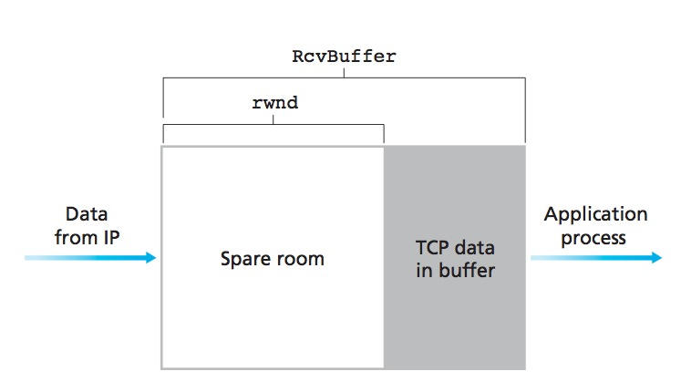
TCP Flow-Control – Receiver Side
rwnd = RcvBuffer – [LastByteRcvd – LastByteRead]

Slide 5
TCP Flow-Control – Receiver Side
How does the connection use the variable rwnd to provide the flow-control service?
Host B tells Host A how much spare room it has in the connection buffer by placing its current value of rwnd in the receive window field of every segment it sends to A.
Initially, Host B sets rwnd = RcvBuffer.
How many rwnd variables should the Host B keep?
One for each connection

Slide 6
TCP Flow-Control – Sender Side
What variables Host A should keep?
LastByteSent and LastByteAcked
LastByteSent – LastByteAcked, is the amount of unacknowledged data that A has sent into the connection
For flow control, Host A keeps the amount of unacknowledged data less than the value of rwnd
LastByteSent – LastByteAcked <= rwnd

Slide 7
One special case …
Host B’s receive buffer becomes full so that rwnd = 0
After advertising rwnd = 0 to Host A, also suppose that B has nothing to send to A
When buffer empties, how would A know?
Solution:
Host A continues to send segments with one data byte when B’s receive window is zero
These segments will be acknowledged by the receiver. Eventually the buffer will begin to empty and the acknowledgments will contain a nonzero rwnd value

Slide 8
TCP flow control
flow control: # bytes receiver willing to accept
TCP receiver “advertises” free buffer space in rwnd field in TCP header
RcvBuffer size set via socket options (typical default is 4096 bytes)
many operating systems autoadjust RcvBuffer
sender limits amount of unACKed (“in-flight”) data to received rwnd
guarantees receive buffer will not overflow
receive window
TCP segment format
Notes:
Here’s how TCP implement flow control. The basic idea is simple – the receiver informs the sender how much free buffer space there is, and the sender is limited to send no more than this amount of data. That the value o RWND in the diagram to the right.
This information is carried from the receiver to the sender in the “receiver advertised window” (do a PIP of header) in the TCP header, and the value will change as the amount of free buffer space fluctuates over time.

Slide 9

TCP connection management
before exchanging data, sender/receiver “handshake”:
agree to establish connection (each knowing the other willing to establish connection)
agree on connection parameters (e.g., starting seq #s)
application
application
connection state: ESTAB
connection variables:
seq # client-to-server
server-to-client
rcvBuffer size
at server,client
connection state: ESTAB
connection Variables:
seq # client-to-server
server-to-client
rcvBuffer size
at server,client
network
network
Socket clientSocket =
newSocket("hostname","port number");
Socket connectionSocket = welcomeSocket.accept();
Notes:
The other TCP topic we’ll want to consider here is that of “connection management”
The TCP sender and reciver have a number of pieces of shared state that they must establish before actually communication
FIRST theym ust both agree that they WANT to communicate with each other
Secondly there are connection parameters – the initial sequence number and the initial receiver-advertised bufferspace that they’ll want to agree on
This is done via a so-called handshake protocol – the client reaching our to the server, and the server answering back.
And before diving into the TCP handshake protocol, let’s first consider the problem of handshaking, of establishing shared state.

Slide 10


Agreeing to establish a connection
2-way handshake:
Q: will 2-way handshake always work in network?
variable delays
retransmitted messages (e.g. req_conn(x)) due to message loss
message reordering
can’t “see” other side
Let’s talk
ESTAB
OK
ESTAB
choose x
req_conn(x)
ESTAB
acc_conn(x)
ESTAB
Notes:
Here’s an example of a two way handshake. Alice reaches out to Bob and say’s “let’s talk” and Bob says OK, and they start their conversation
For a network protocol, the equivalent protocol would be a client sending a “request connection” message saying ”let’s talk, the initial sequence number is x”
And the server would respond with a message ”I accept your connect x”
And the question we want to ask ourselves is <talk through>
Will this work? Let’s look at a few scenarios…

Slide 11

2-way handshake scenarios
choose x
req_conn(x)
ESTAB
acc_conn(x)
ESTAB
data(x+1)
accept
data(x+1)
ACK(x+1)
connection
x completes
No problem!

Slide 12

2-way handshake scenarios
choose x
req_conn(x)
ESTAB
retransmit
req_conn(x)
acc_conn(x)
ESTAB
req_conn(x)
connection
x completes
client terminates
server
forgets x
ESTAB
acc_conn(x)
Problem: half open connection! (no client)

Slide 13
2-way handshake scenarios
choose x
req_conn(x)
ESTAB
retransmit
req_conn(x)
acc_conn(x)
ESTAB
data(x+1)
accept
data(x+1)
retransmit
data(x+1)
connection
x completes
client terminates
server
forgets x
req_conn(x)
ESTAB
data(x+1)
accept
data(x+1)
Problem: dup data
accepted!

Slide 14
TCP 3-way handshake
Server state
Client state
serverSocket = socket(AF_INET,SOCK_STREAM)
serverSocket.bind((‘’,serverPort))
serverSocket.listen(1)
connectionSocket, addr = serverSocket.accept()
clientSocket = socket(AF_INET, SOCK_STREAM)
LISTEN
clientSocket.connect((serverName,serverPort))
LISTEN
choose init seq num, x
send TCP SYN msg
SYNSENT
SYNbit=1, Seq=x
choose init seq num, y
send TCP SYNACK
msg, acking SYN
SYN RCVD
SYNbit=1, Seq=y
ACKbit=1; ACKnum=x+1
received SYNACK(x)
indicates server is live;
send ACK for SYNACK;
this segment may contain
client-to-server data
ESTAB
ACKbit=1, ACKnum=y+1
received ACK(y)
indicates client is live
ESTAB
Notes:
TCP’s three way handshake, that operates as follows
Let’s say the client and server both create a TCP socket as we learned about in Chapter 2 and enter the LISTEN state
The client then connects to the server sending a SYN message with a sequence number x (SYN Message is an TCP Segment with SYN but set in the header – you might want to go back and review the TCP segment format!)
The server is waiting for a connection, and receives the SYN message enters the SYN received state (NOT the established state and sends a SYN ACK message back.
Finally the client sends an ACK message to the server, and when the server receiver this enters the ESTABLished state. This is when the application process would see the return from the wait on the socket accept() call

Slide 15
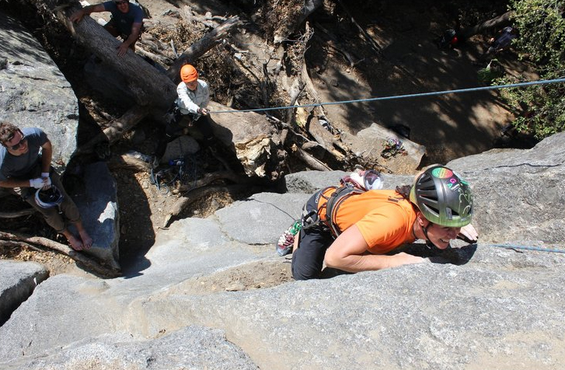
A human 3-way handshake protocol
1. On belay?
2. Belay on.
3. Climbing.
Notes:
As usual, there’s a human protocol analogy to the three way handshake, and I still remember thinking about this clinging for my life while climbing up a rockface
When you want start climbing you first say ON BELOW (meaning ARE YOU READY WITH MY SAFETY ROPE)
THE BELYER (server) responds BELAY ON (that lets you know the belayer is ready for you)
And then you say CLIMING
It’s amazing what can pass through your head when your clinging for your life o a

Slide 16
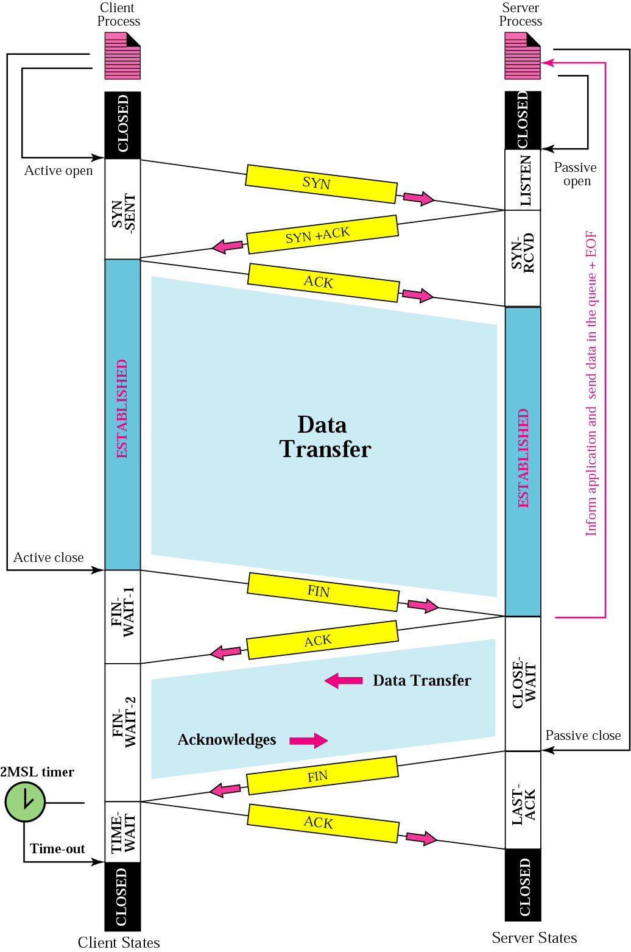
Closing a TCP connection
client, server each close their side of connection
send TCP segment with FIN bit = 1
respond to received FIN with ACK
on receiving FIN, ACK can be combined with own FIN
simultaneous FIN exchanges can be handled
Notes:
All good things must come to an end, and that’s true for a TCP connection as well.
And of course there’s a protocol for one side to gracefully close of a TCP connection using a FIN message, to which the other side sends a FINACK message and waits around a bit to respond to any retransmitted FIN messages before timing out.

Slide 17
Closing a TCP connection
client state
server state
ESTAB
ESTAB
clientSocket.close()
FIN_WAIT_1
can no longer
send but can
receive data
FINbit=1, seq=x
CLOSE_WAIT
ACKbit=1; ACKnum=x+1
can still
send data
FIN_WAIT_2
wait for server
close
LAST_ACK
FINbit=1, seq=y
TIMED_WAIT
can no longer
send data
ACKbit=1; ACKnum=y+1
timed wait
for 2*max
segment lifetime
CLOSED
CLOSED

Slide 18

Chapter 3: roadmap
Transport-layer services
Multiplexing and demultiplexing
Connectionless transport: UDP
Principles of reliable data transfer
Connection-oriented transport: TCP
Principles of congestion control
TCP congestion control
Evolution of transport-layer functionality

Slide 19
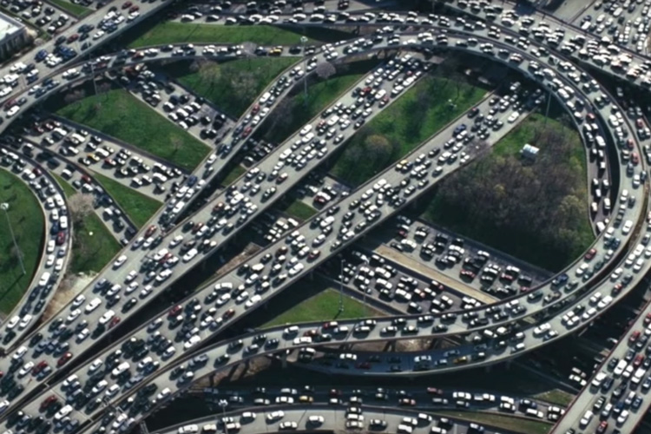


Principles of congestion control
Congestion:
informally: “too many sources sending too much data too fast for network to handle”
manifestations:
long delays (queueing in router buffers)
packet loss (buffer overflow at routers)
different from flow control!
congestion control: too many senders, sending too fast
a top-10 problem!
flow control: one sender too fast for one receiver

Slide 20
Flow vs. Congestion Control

Slide 21
Causes/costs of congestion: scenario 1
original data: λ_{in}
throughput: λ_{out}
Simplest scenario:
Host A
one router, infinite buffers
input, output link capacity: R
infinite shared output link buffers
two flows
R
R
no retransmissions needed
Host B
R/2
Q: What happens as arrival rate λ_{in} approaches R/2?
λ_{out}
delay
throughput:
λ_{in}
R/2
λ_{in}
R/2
maximum per-connection throughput: R/2
large delays as arrival rate λ_{in} approaches capacity
R/2
Notes:
Ideal case. ..

Slide 22
Causes/costs of congestion: scenario 2
one router, finite buffers
sender retransmits lost, timed-out packet
application-layer input = application-layer output: λ_{in} = λ_{out}
transport-layer input includes retransmissions : λ’_{in} λ_{in}
Host A
λ_{in} : original data
λ'_{in}: original data, plus retransmitted data
λ_{out}
R
R
Host B
finite shared output link buffers

Slide 23
Causes/costs of congestion: scenario 2
Idealization: perfect knowledge
sender sends only when router buffers available
R/2
λ_{out}
throughput:
Host A
λ_{in} : original data
λ_{in}
copy
λ'_{in}: original data, plus retransmitted data
λ_{out}
R/2
free buffer space!
R
R
Host B
finite shared output link buffers

Slide 24
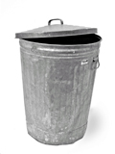
Causes/costs of congestion: scenario 2
Idealization: some perfect knowledge
packets can be lost (dropped at router) due to full buffers
sender knows when packet has been dropped: only resends if packet known to be lost
Host A
λ_{in} : original data
copy
λ'_{in}: original data, plus retransmitted data
no buffer space!
R
R
Host B
finite shared output link buffers

Slide 25
Causes/costs of congestion: scenario 2
Idealization: some perfect knowledge
packets can be lost (dropped at router) due to full buffers
sender knows when packet has been dropped: only resends if packet known to be lost
R/2
λ_{out}
“wasted” capacity due to retransmissions
when sending at R/2, some packets are needed retransmissions
throughput:
Host A
λ_{in} : original data
λ_{in}
λ'_{in}: original data, plus retransmitted data
R/2
free buffer space!
R
R
Host B
finite shared output link buffers

Slide 26


Causes/costs of congestion: scenario 2
Realistic scenario: un-needed duplicates
packets can be lost, dropped at router due to full buffers – requiring retransmissions
but sender times can time out prematurely, sending two copies, both of which are delivered
R/2
λ_{out}
“wasted” capacity due to un-needed retransmissions
throughput:
when sending at R/2, some packets are retransmissions, including needed and un-needed duplicates, that are delivered!
Host A
λ_{in} : original data
λ_{in}
copy
λ'_{in}: original data, plus retransmitted data
R/2
timeout
free buffer space!
R
R
Host B
finite shared output link buffers

Slide 27
Causes/costs of congestion: scenario 2
Realistic scenario: un-needed duplicates
packets can be lost, dropped at router due to full buffers – requiring retransmissions
but sender times can time out prematurely, sending two copies, both of which are delivered
R/2
λ_{out}
“wasted” capacity due to un-needed retransmissions
throughput:
when sending at R/2, some packets are retransmissions, including needed and un-needed duplicates, that are delivered!
λ_{in}
R/2
“costs” of congestion:
more work (retransmission) for given receiver throughput
unneeded retransmissions: link carries multiple copies of a packet
decreasing maximum achievable throughput

Slide 28
Causes/costs of congestion: scenario 3
four senders
multi-hop paths
timeout/retransmit
Q: what happens as λ_{in} and λ_{in}’ increase ?
A: as red λ_{in}’ increases, all arriving blue pkts at upper queue are dropped, blue throughput g 0
Host A
λ_{in} : original data
λ'_{in}: original data, plus retransmitted data
Host B
finite shared output link buffers
Host D
λ_{out}
Host C

Slide 29
Causes/costs of congestion: scenario 3
R/2
λ_{out}
λ_{in}’
R/2
another “cost” of congestion:
when packet dropped, any upstream transmission capacity and buffering used for that packet was wasted!

Slide 30
Causes/costs of congestion: insights
throughput can never exceed capacity
delay increases as capacity approached
loss/retransmission decreases effective throughput
un-needed duplicates further decreases effective throughput
upstream transmission capacity / buffering wasted for packets lost downstream

Slide 31
Approaches towards congestion control
End-end congestion control:
no explicit feedback from network
congestion inferred from observed loss, delay
ACKs
data
data
ACKs
approach taken by TCP

Slide 32
Approaches towards congestion control
Network-assisted congestion control:
routers provide direct feedback to sending/receiving hosts with flows passing through congested router
may indicate congestion level or explicitly set sending rate
explicit congestion info
ACKs
data
data
ACKs
TCP ECN, ATM, DECbit protocols

Slide 33
Chapter 3: roadmap
Transport-layer services
Multiplexing and demultiplexing
Connectionless transport: UDP
Principles of reliable data transfer
Connection-oriented transport: TCP
Principles of congestion control
TCP congestion control
Evolution of transport-layer functionality

Slide 34
TCP congestion control: AIMD
approach: senders can increase sending rate until packet loss (congestion) occurs, then decrease sending rate on loss event
Additive Increase
Multiplicative Decrease
increase sending rate by 1 maximum segment size every RTT until loss detected
cut sending rate in half at each loss event
AIMD sawtooth
behavior: probing
for bandwidth
TCP sender Sending rate
time
Notes:
E covered:

Slide 35
TCP AIMD: more detail
Multiplicative decrease detail: sending rate is
Cut in half on loss detected by triple duplicate ACK (TCP Reno)
Cut to 1 MSS (maximum segment size) when loss detected by timeout (TCP Tahoe)
Why AIMD?
AIMD – a distributed, asynchronous algorithm – has been shown to:
optimize congested flow rates network wide!
have desirable stability properties

Slide 36
TCP congestion control: details
sender sequence number space
TCP sending behavior:
roughly: send cwnd bytes, wait RTT for ACKS, then send more bytes
cwnd
last byte
ACKed
cwnd
sent, but not-yet ACKed
(“in-flight”)
available but not used
TCP rate
~
bytes/sec
~
RTT
last byte sent
TCP sender limits transmission:
cwnd is dynamically adjusted in response to observed network congestion (implementing TCP congestion control)
<
cwnd
LastByteSent- LastByteAcked

Slide 37
TCP slow start
Host A
Host B
when connection begins, increase rate exponentially until first loss event:
initially cwnd = 1 MSS
double cwnd every RTT
done by incrementing cwnd for every ACK received
one segment
RTT
two segments
four segments
summary: initial rate is slow, but ramps up exponentially fast
time

Slide 38
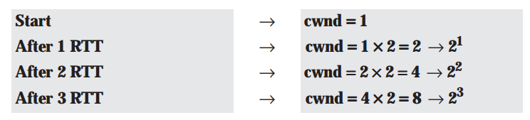
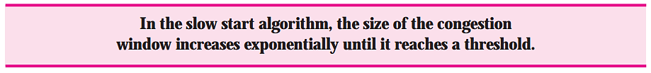
TCP Slow Start (more detail)
If we look at the size of the cwnd in terms of round-trip times (RTTs), we find that the growth rate is exponential as shown below:
Notes:
Slow start cannot continue indefinitely. There must be a threshold to stop this phase.
The sender keeps track of a variable named ssthresh (slow start threshold). When the size of window in bytes reaches this threshold, slow start stops and the next phase starts.

Slide 39
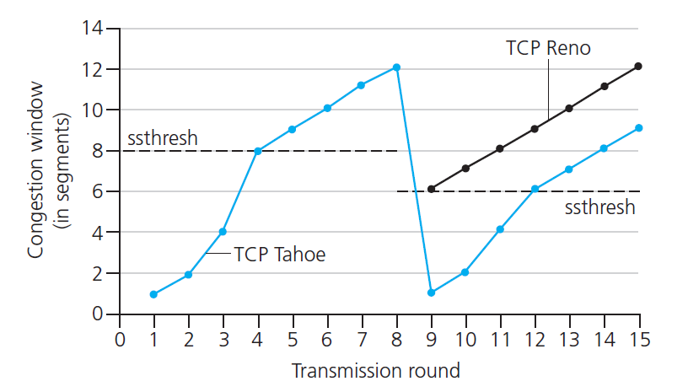

TCP: from slow start to congestion avoidance
Q: when should the exponential increase switch to linear?
A: when cwnd gets to 1/2 of its value before timeout.
X
Implementation:
variable ssthresh
on loss event, ssthresh is set to 1/2 of cwnd just before loss event

Slide 40
Summary: TCP Congestion Control
When cwnd is below ssthresh, sender in slow-start phase, window grows exponentially.
When cwnd is above ssthresh, sender is in congestion-avoidance phase, window grows linearly
When a triple duplicate ACK occurs, ssthresh set to cwnd/2 and cwnd set to ssthresh+3
When timeout occurs, ssthresh set to cwnd/2 and cwnd is set to 1 MSS

Slide 41
Summary: TCP congestion control
New
ACK!
New
ACK!
.
duplicate ACK
new ACK
dupACKcount++
new ACK
cwnd = cwnd + MSS (MSS/cwnd)
dupACKcount = 0
transmit new segment(s), as allowed
cwnd = cwnd+MSS
dupACKcount = 0
transmit new segment(s), as allowed
Λ
cwnd = 1 MSS
ssthresh = 64 KB
dupACKcount = 0
cwnd > ssthresh
slow
start
Λ
congestion
avoidance
timeout
ssthresh = cwnd/2
cwnd = 1 MSS
dupACKcount = 0
retransmit missing segment
duplicate ACK
timeout
dupACKcount++
ssthresh = cwnd/2
cwnd = 1 MSS
dupACKcount = 0
retransmit missing segment
timeout
New
ACK!
ssthresh = cwnd/2
cwnd = 1 MSS
dupACKcount = 0
retransmit missing segment
New ACK
dupACKcount == 3
cwnd = ssthresh
dupACKcount = 0
dupACKcount == 3
ssthresh= cwnd/2
cwnd = ssthresh + 3
retransmit missing segment
ssthresh= cwnd/2
cwnd = ssthresh + 3
retransmit missing segment
fast
recovery
duplicate ACK
cwnd = cwnd + MSS
transmit new segment(s), as allowed

Slide 42
When does the Slow Start end?
First, if there is a loss event (i.e., congestion) indicated by a timeout,
TCP sender sets the value of cwnd to 1, restart Slow Start
ssthresh variable (“slow start threshold”) to cwnd/2
The second way in which slow start may end is directly tied to the value of ssthresh
When cwnd equals ssthresh, slow start ends and TCP transitions into congestion avoidance mode
Why not keep doubling?
The final way in which slow start can end is if three duplicate ACKs are detected,
TCP performs a fast retransmit and enters the fast recovery state

Slide 43
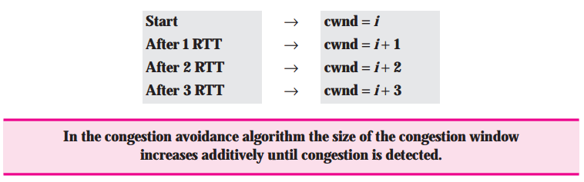
TCP Congestion Control - Congestion Avoidance
When do we get to this state
value of cwnd is approximately half its value when congestion was last encountered
congestion could be just around the corner!
Rather than doubling the value of cwnd every RTT, TCP adopts a more conservative approach and increases the value of cwnd by just a single MSS every RTT
Notes:
This can be accomplished in several ways.
TCP sender increases cwnd by MSS bytes (MSS/cwnd) when- ever a new acknowledgment arrives.
For example, if MSS is 1,460 bytes and cwnd is 14,600 bytes, then 10 segments are being sent within an RTT.
Each arriving ACK (assuming one ACK per segment) increases the congestion window size by 1/10 MSS (146 bytes).

Slide 44
Slow start with Congestion avoidance
When does it end?
TCP’s congestion-avoidance algorithm behaves the same when a timeout occurs
On time out: Congestion avoidance
Set ssthresh = cwnd/2 ; cwnd =1
Drawback
Slow recovery from losses
Timeout drain the pipe -> Forces one to do slow start which takes time to fill the pipe

Slide 45
TCP Congestion Control - Fast Recovery
When do we get to this state?
loss event also can be triggered by a triple duplicate ACK event
In this case, the network is continuing to deliver segments from sender to receiver
So TCP’s behavior to this type of loss event should be less drastic than with a timeout-indicated loss
Idea: each dup ACK represents a packet successfully received. Therefore, no need for very drastic action

Slide 46
TCP Congestion Control - Fast Recovery
What does TCP do?
TCP halves the value of cwnd (adding in 3 MSS)
ssthresh half the value of cwnd
cwnd is increased by 1 MSS for every duplicate ACK received for the missing segment that caused TCP to enter the fast-recovery state.
set SSThresh = CWND/2
set CWND = SSThresh + 3

Slide 47
TCP Congestion Control - Fast Recovery
When does it end?
when an ACK arrives for the missing segment, TCP enters the congestion-avoidance state.
If a timeout event occurs, fast recovery transitions to the slow-start state
Generally, fast retransmit eliminates about half the coarse-grain timeouts.
This yields roughly a 20% improvement in throughput

Slide 48
TCP Congestion Control - Fast Recovery
Fast recovery is a recommended, but not required, component of TCP
Early version of TCP, TCP Tahoe, unconditionally cut its congestion window to 1 MSS.
The newer version of TCP, TCP Reno, incorporated fast recovery.

Slide 49
TCP CUBIC
Is there a better way than AIMD to “probe” for usable bandwidth?
Insight/intuition:
W_{max}: sending rate at which congestion loss was detected
congestion state of bottleneck link probably (?) hasn’t changed much
after cutting rate/window in half on loss, initially ramp to to W_{max} faster, but then approach W_{max} more slowly
W_{max}
classic TCP
TCP CUBIC - higher throughput in this example
W_{max}/2

Slide 50
TCP CUBIC
K: point in time when TCP window size will reach W_{max}
K itself is tuneable
increase W as a function of the cube of the distance between current time and K
larger increases when further away from K
smaller increases (cautious) when nearer K
TCP CUBIC default in Linux, most popular TCP for popular Web servers
W_{max}
TCP Reno
TCP CUBIC
TCP
sending
rate
time
t₀
t₁
t₂
t₃
t₄

Slide 51
TCP and the congested “bottleneck link”
TCP (classic, CUBIC) increase TCP’s sending rate until packet loss occurs at some router’s output: the bottleneck link
source
destination
application
TCP
network
link
physical
application
TCP
network
link
physical
packet queue almost never empty, sometimes overflows packet (loss)
bottleneck link (almost always busy)

Slide 52
TCP and the congested “bottleneck link”
TCP (classic, CUBIC) increase TCP’s sending rate until packet loss occurs at some router’s output: the bottleneck link
understanding congestion: useful to focus on congested bottleneck link
insight: increasing TCP sending rate will not increase end-end throughout with congested bottleneck
source
destination
application
TCP
network
link
physical
application
TCP
network
link
physical
insight: increasing TCP sending rate will increase measured RTT
Goal: “keep the end-end pipe just full, but not fuller”
RTT

Slide 53
Delay-based TCP congestion control
Keeping sender-to-receiver pipe “just full enough, but no fuller”: keep bottleneck link busy transmitting, but avoid high delays/buffering
# bytes sent in last RTT interval
RTT_{measured}
measured
throughput
=
RTT_{measured}
Delay-based approach:
RTT_{min} - minimum observed RTT (uncongested path)
uncongested throughput with congestion window cwnd is cwnd/RTT_{min}
if measured throughput “very close” to uncongested throughput
increase cwnd linearly /* since path not congested */
else if measured throughput “far below” uncongested throughout
decrease cwnd linearly /* since path is congested */

Slide 54
Delay-based TCP congestion control
congestion control without inducing/forcing loss
maximizing throughout (“keeping the just pipe full… ”) while keeping delay low (“…but not fuller”)
a number of deployed TCPs take a delay-based approach
BBR deployed on Google’s (internal) backbone network

Slide 55
Explicit congestion notification (ECN)
TCP deployments often implement network-assisted congestion control:
two bits in IP header (ToS field) marked by network router to indicate congestion
policy to determine marking chosen by network operator
congestion indication carried to destination
destination sets ECE bit on ACK segment to notify sender of congestion
involves both IP (IP header ECN bit marking) and TCP (TCP header C,E bit marking)
source
TCP ACK segment
destination
application
TCP
network
link
physical
application
TCP
network
link
physical
ECE=1
ECN=10
ECN=11
IP datagram

Slide 56
TCP fairness
Fairness goal: if K TCP sessions share same bottleneck link of bandwidth R, each should have average rate of R/K
TCP connection 1
bottleneck
router
capacity R
TCP connection 2

Slide 57
Q: is TCP Fair?
Example: two competing TCP sessions:
additive increase gives slope of 1, as throughout increases
multiplicative decrease decreases throughput proportionally
R
equal bandwidth share
Is TCP fair?
A: Yes, under idealized assumptions:
same RTT
fixed number of sessions only in congestion avoidance
loss: decrease window by factor of 2
congestion avoidance: additive increase
Connection 2 throughput
loss: decrease window by factor of 2
congestion avoidance: additive increase
Connection 1 throughput
R

Slide 58
Fairness: must all network apps be “fair”?
Fairness and UDP
multimedia apps often do not use TCP
do not want rate throttled by congestion control
instead use UDP:
send audio/video at constant rate, tolerate packet loss
there is no “Internet police” policing use of congestion control
Fairness, parallel TCP connections
application can open multiple parallel connections between two hosts
web browsers do this , e.g., link of rate R with 9 existing connections:
new app asks for 1 TCP, gets rate R/10
new app asks for 11 TCPs, gets R/20

Slide 59
Transport layer: roadmap
Transport-layer services
Multiplexing and demultiplexing
Connectionless transport: UDP
Principles of reliable data transfer
Connection-oriented transport: TCP
Principles of congestion control
TCP congestion control
Evolution of transport-layer functionality

Slide 60
Evolving transport-layer functionality
TCP, UDP: principal transport protocols for 40 years
different “flavors” of TCP developed, for specific scenarios:
Scenario | Challenges
Long, fat pipes (large data transfers) | Many packets “in flight”; loss shuts down pipeline
Wireless networks | Loss due to noisy wireless links, mobility; TCP treat this as congestion loss
Long-delay links | Extremely long RTTs
Data center networks | Latency sensitive
Background traffic flows | Low priority, “background” TCP flows
moving transport–layer functions to application layer, on top of UDP
HTTP/3: QUIC

Slide 61
QUIC: Quick UDP Internet Connections
application-layer protocol, on top of UDP
increase performance of HTTP
deployed on many Google servers, apps (Chrome, mobile YouTube app)
HTTP/2
HTTP/2 (slimmed)
Application
HTTP/3
TLS
QUIC
Transport
TCP
UDP
Network
IP
IP
HTTP/2 over TCP
HTTP/2 over QUIC over UDP

Slide 62
QUIC: Quick UDP Internet Connections
adopts approaches we’ve studied in this chapter for connection establishment, error control, congestion control
error and congestion control: “Readers familiar with TCP’s loss detection and congestion control will find algorithms here that parallel well-known TCP ones.” [from QUIC specification]
connection establishment: reliability, congestion control, authentication, encryption, state established in one RTT
multiple application-level “streams” multiplexed over single QUIC connection
separate reliable data transfer, security
common congestion control

Slide 63
QUIC: Connection establishment
TCP handshake
(transport layer)
QUIC handshake
data
TLS handshake
(security)
data
TCP (reliability, congestion control state) + TLS (authentication, crypto state)
2 serial handshakes
QUIC: reliability, congestion control, authentication, crypto state
1 handshake

Slide 64
QUIC: streams: parallelism, no HOL blocking
HTTP
GET
HTTP
GET
HTTP
GET
HTTP
GET
HTTP
GET
application
HTTP
GET
QUIC
encrypt
QUIC
encrypt
QUIC
encrypt
QUIC
encrypt
QUIC
encrypt
QUIC
encrypt
TLS encryption
TLS encryption
QUIC
RDT
QUIC
RDT
QUIC
RDT
QUIC
RDT
QUIC
RDT
QUIC
RDT
error!
QUIC Cong. Cont.
QUIC Cong. Cont.
TCP RDT
TCP RDT
error!
transport
TCP Cong. Contr.
TCP Cong. Contr.
UDP
UDP
(a) HTTP 1.1
(b) HTTP/2 with QUIC: no HOL blocking

Slide 65
Chapter 3: summary
principles behind transport layer services:
multiplexing, demultiplexing
reliable data transfer
flow control
congestion control
instantiation, implementation in the Internet
UDP
TCP
Up next:
leaving the network “edge” (application, transport layers)
into the network “core”
two network-layer chapters:
data plane
control plane

Slide 66
Flow control and congestion control applets
Flow control applets:
https://media.pearsoncmg.com/aw/ecs_kurose_compnetwork_7/cw/content/interactiveanimations/flow-control/index.html
Congestion control
https://media.pearsoncmg.com/aw/ecs_kurose_compnetwork_7/cw/content/interactiveanimations/tcp-congestion/index.html

Slide 67


Thank You All
☺
?
A note on the origin of these ppt slides:
All material copyright 1996-2020 J.F Kurose and K.W. Ross, All Rights Reserved
These slides are freely provided by the book authors and it represents a lot of work on their part. We would like to thank J.F Kurose and K.W. Ross.
Transport Layer: 3-150
Notes:
Section F and G ended

